Slide 1
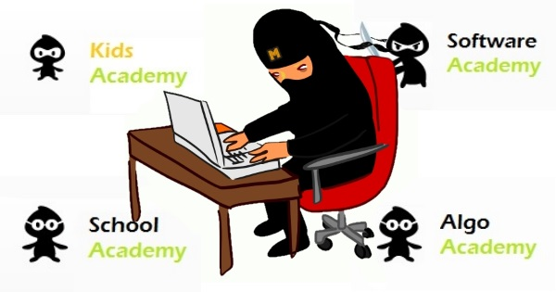
Team Project Mimosa
Aleksandra92(Mom), a.k.filipov(Dad), Dragomir.Tachev and Hristiyan_Andreev(the Kids) and ahansb(uncle Fester)

Slide 2
Content:
The App
App requirements coverage
Live Demo
Source Code
The Team

Slide 3
App requirements coverage
jQuery usage
OOP Design
Modules
Objects
Unit Testing
UI Implementation
Web Data Storage
Parse
Usage of localStorage
Usage of Tweeter Bootstrap
Responsive to different resolutions
Third-party API
Facebook Sharing
The data is encapsulated with strong cohesion and loose coupling
Hosted on http://github.com
Implementation of server-side logic with Node.js
Hosted on http://heroku.com

Slide 4
Team Mimosa Application /live demo/
http://mimosas.herokuapp.com/

Slide 5
Team Mimosa Application /Source Code/
https://github.com/TeamMimosa-Telerik

Slide 6
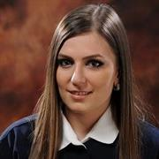
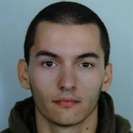
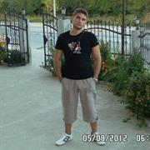
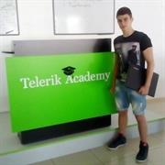
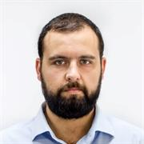
Mimosa Team
Aleksandra92(Mom)
a.k.filipov(Dad)
Dragomir.Tachev(Kid)
Hristiyan_Andreev(Kid)
ahansb(uncle Fester)

Slide 7
Thank you!
Mimosa Team

